Slide 1


ML.NET for C# Developers: Your Learning Journey
This presentation outlines the essential prerequisites, syllabus, and resources for learning ML.NET, a machine learning framework specifically designed for C# developers. We'll explore key concepts, set up your development environment, and dive into building your first machine learning model.
by RAJESH KUMAR

Slide 2
Why ML.NET? C# Integration and Use Cases
Seamless Integration
Diverse Use Cases
ML.NET empowers C# developers to leverage powerful machine learning algorithms within their .NET applications, enabling them to build intelligent solutions without leaving the familiar C# ecosystem.
From image classification and sentiment analysis to fraud detection and recommendation engines, ML.NET caters to a wide range of use cases, offering a flexible framework for addressing various real-world problems.

Slide 3

C# & .NET Fundamentals for ML.NET
1
C# Proficiency
2
.NET Framework Familiarity
3
Object-Oriented Programming
A strong foundation in C# is critical. Understanding concepts like data types, variables, operators, loops, and conditional statements is essential for working with ML.NET.
Experience with the .NET framework, including .NET Core or .NET 5/6/7+, is beneficial, as it provides the context for building applications that utilize ML.NET capabilities.
A firm grasp of OOP principles like classes, objects, inheritance, and polymorphism is vital for designing and implementing ML.NET models effectively.

Slide 4
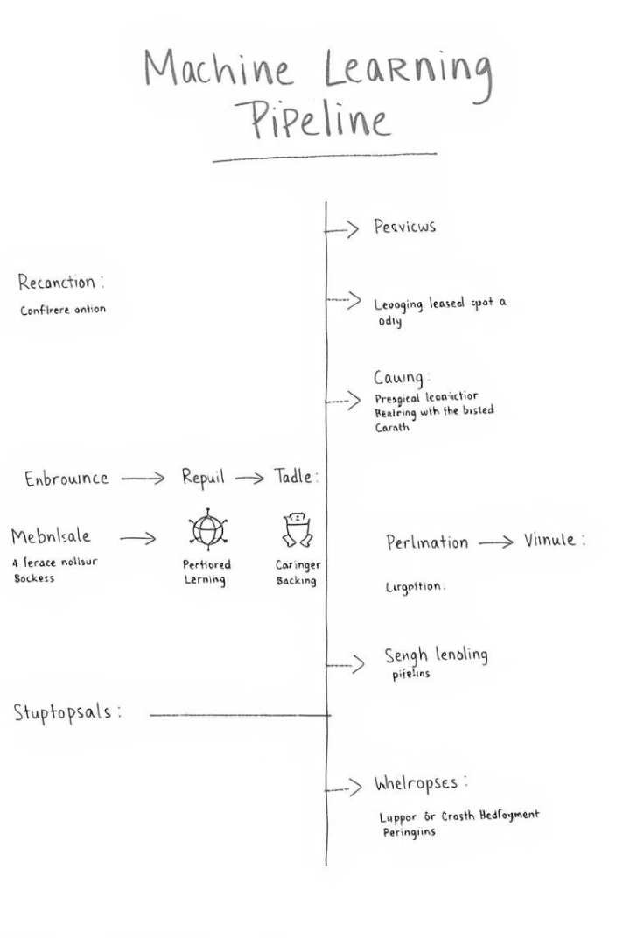
Understanding Machine Learning Concepts
1
Data Preparation
Cleaning, transforming, and preparing your data is a critical step in any ML.NET project, ensuring data quality and readiness for model training.
2
Model Training
Train a model based on your prepared data, selecting the appropriate algorithms and hyperparameters to optimize performance.
3
Model Evaluation
Evaluate the trained model's performance using metrics like accuracy, precision, and recall to ensure it meets your desired level of accuracy.
4
Model Deployment
Deploy your trained model to a .NET application or service, enabling it to make predictions and deliver valuable insights.

Slide 5

Setting Up Your Development Environment
Install Visual Studio
Download and install the latest version of Visual Studio, ensuring it includes the necessary .NET SDK and ML.NET workloads.
Create a .NET Project
Create a new .NET Core or .NET 5/6/7+ project, either console or web application, to serve as your development environment.
Install ML.NET Package
Add the ML.NET package to your project using NuGet Package Manager or the command line, making ML.NET readily available for your project.

Slide 6
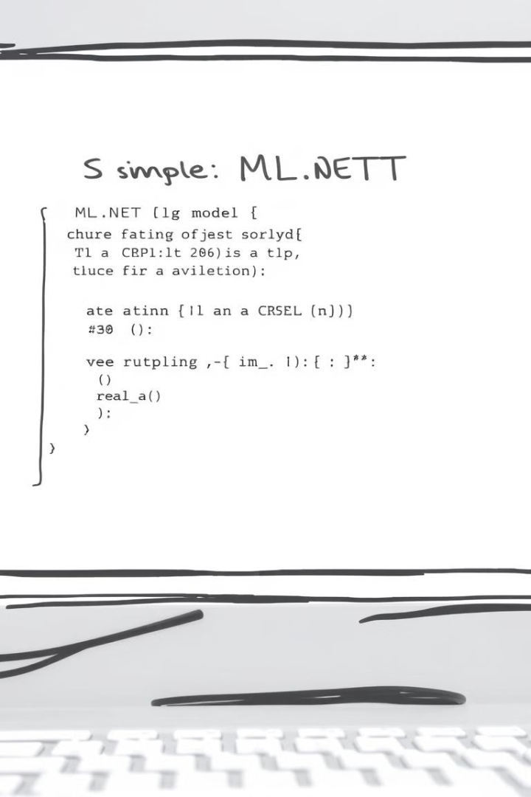




Building Your First ML.NET Model
Choose a Scenario
Select a basic machine learning scenario, such as image classification, sentiment analysis, or price prediction, for your first ML.NET project.
Prepare Data
Acquire and prepare your training data, ensuring it is clean, relevant, and structured for optimal model training.
Train a Model
Use the ML.NET API to train a model based on your chosen scenario and data, specifying the desired algorithm.
Predict with Model
Test your trained model by providing new data and obtaining predictions, validating its accuracy and effectiveness.

Slide 7
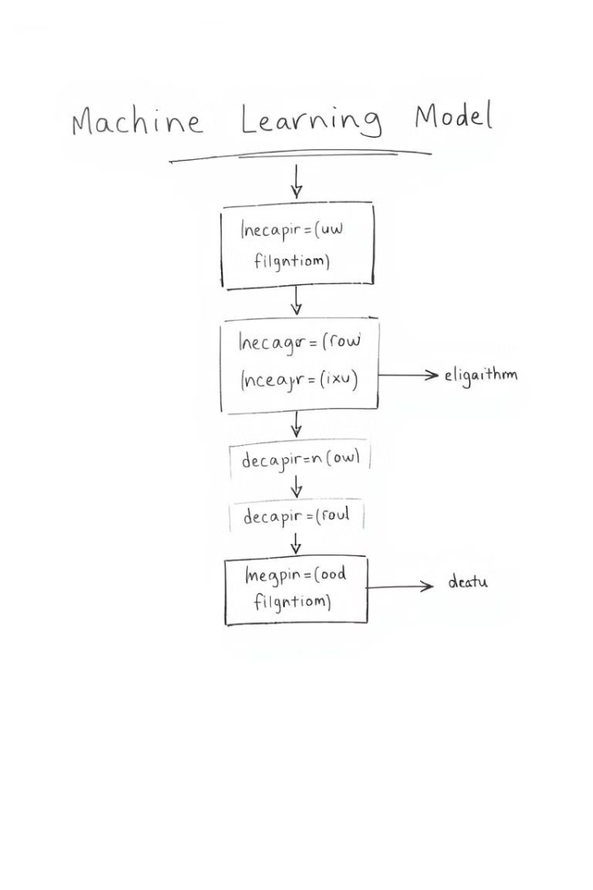
Diving Deeper: Feature Engineering & Algorithms
Feature Engineering
Algorithm Selection
Learn about feature engineering techniques to transform and refine your data, improving model accuracy and performance.
Explore various machine learning algorithms, understanding their strengths and weaknesses to choose the best algorithm for your task.
Model Optimization
Optimize your model's performance by tuning hyperparameters, experimenting with different algorithms, and refining data processing steps.

Slide 8




Resources & Next Steps: Continue Your ML.NET Education
Microsoft Learn
ML.NET Community
Practice & Experiment
Explore the Microsoft Learn platform for comprehensive tutorials, hands-on labs, and learning paths focused on ML.NET.
Engage with the active ML.NET community on forums and social media for support, discussions, and sharing of knowledge.
Continuously practice building ML.NET models for diverse scenarios, experimenting with different algorithms and data sets.

